Slide 1

Roll No:- 2402102031
Analog & Mix-Signal Lab
Differential Amplifers Circuits

Slide 2
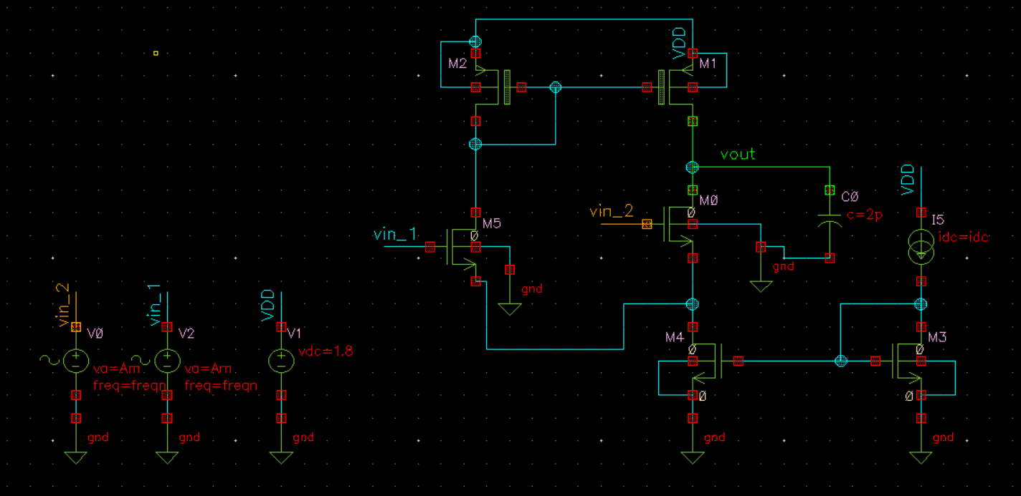
Differential Amplifier :-
Circuit diagram :-

Slide 3
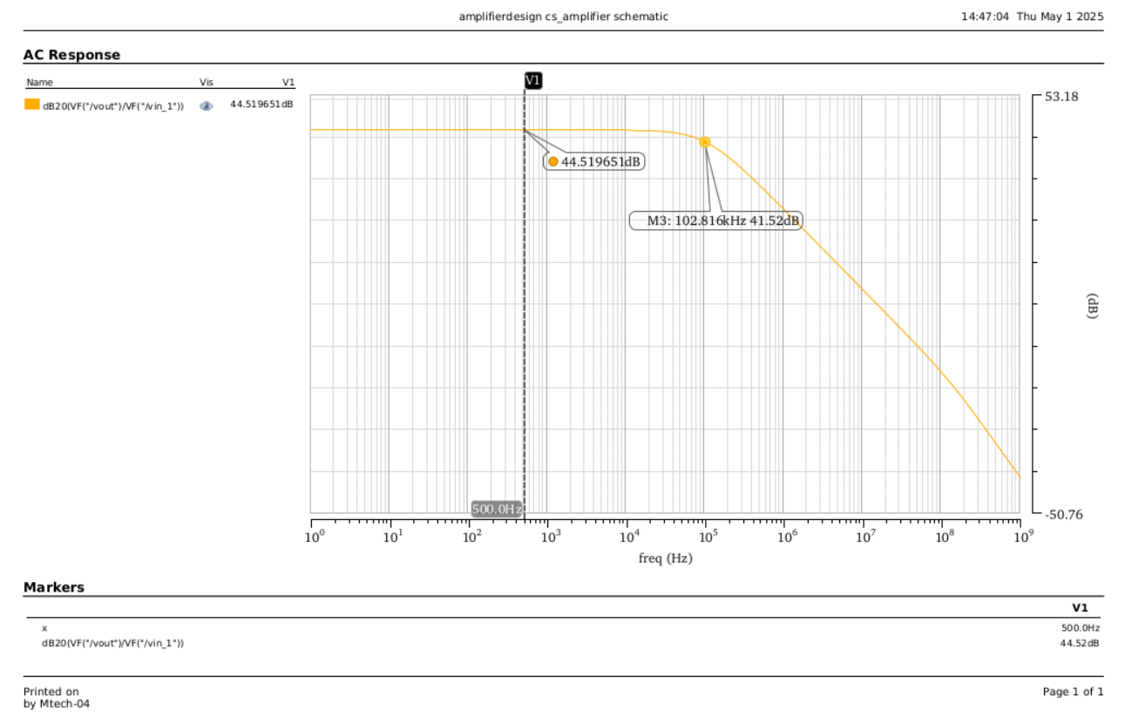
Differential Amplifier :-
AC_analysis :-
VCM = 0.8V
20log(Vout/Vin_1) :-

Slide 4
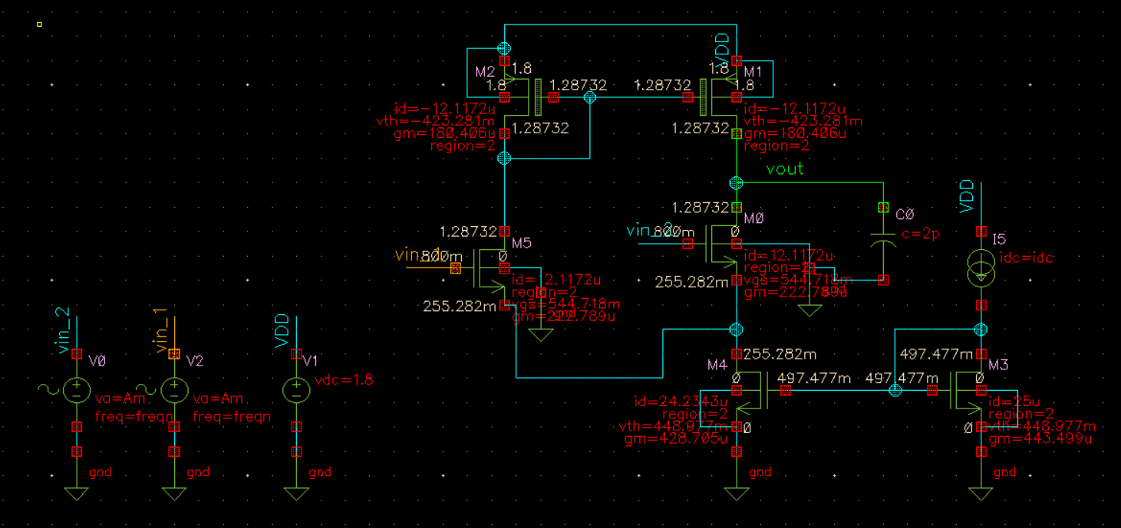
Differential Amplifier :-
DC analysis circuit diagram :-
VCM = 0.8V

Slide 5
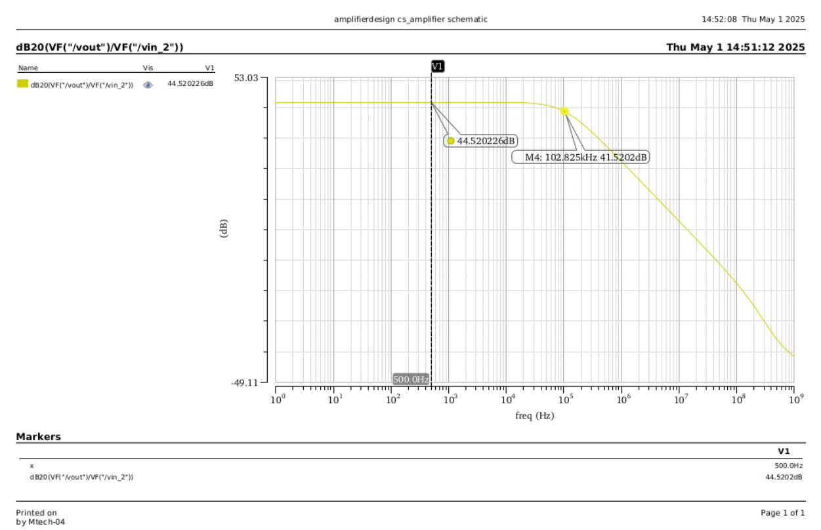
Differential Amplifier :-
AC_analysis :-
VCM = 0.8V
20log(Vout/Vin_2) :-

Slide 6
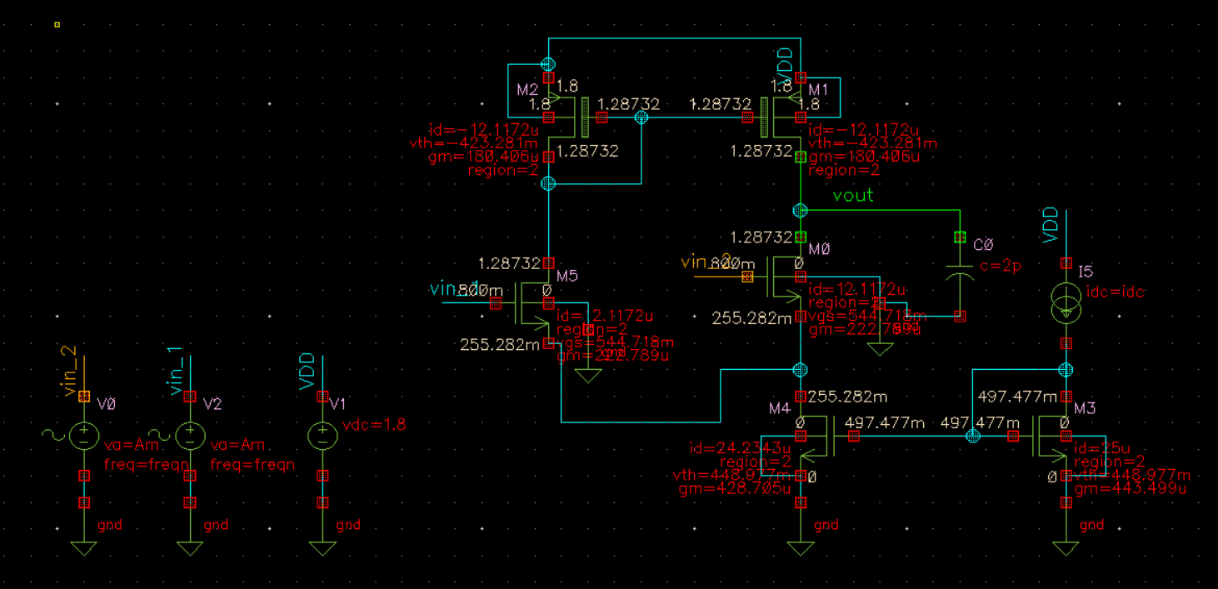
Differential Amplifier :-
DC analysis circuit diagram :-
VCM = 0.8V

Slide 7
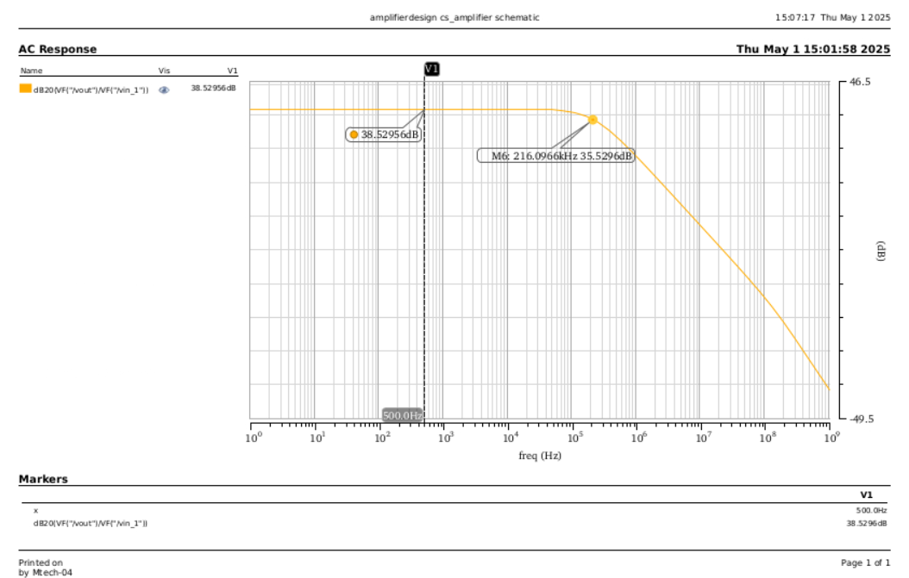
Differential Amplifier :-
AC_analysis :-
VCM = 1.6V
20log(Vout/Vin_1) :-

Slide 8
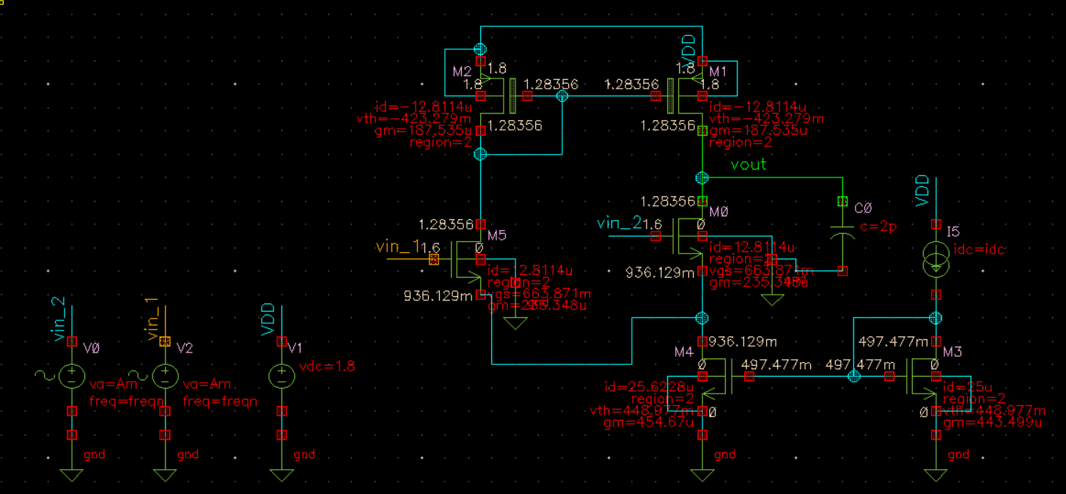
Differential Amplifier :-
DC analysis circuit diagram :-
VCM = 1.6V

Slide 9
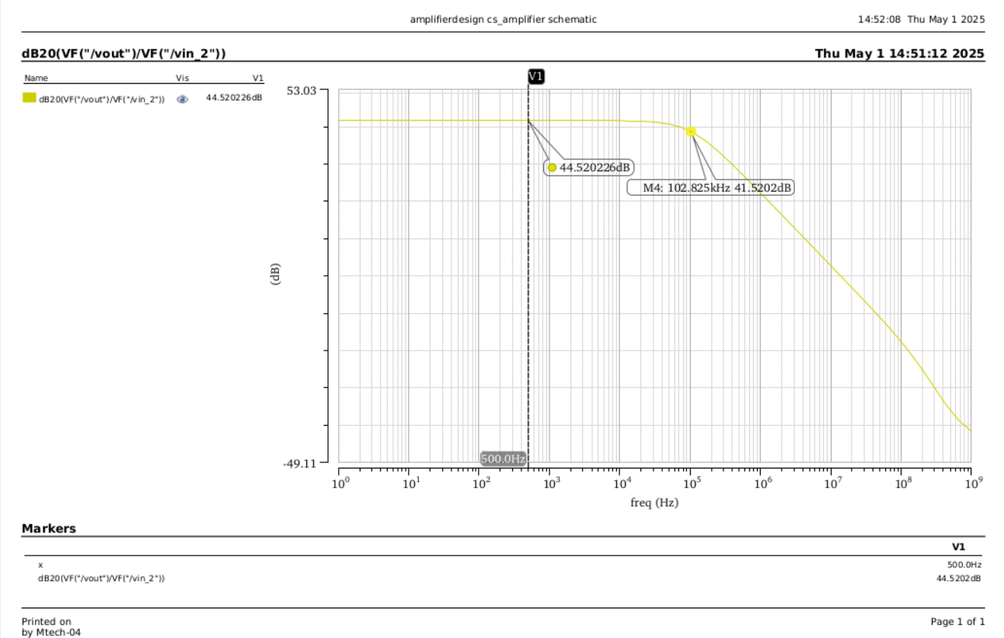
Differential Amplifier :-
AC_analysis :-
VCM = 1.6V
20log(Vout/Vin_2) :-

Slide 10
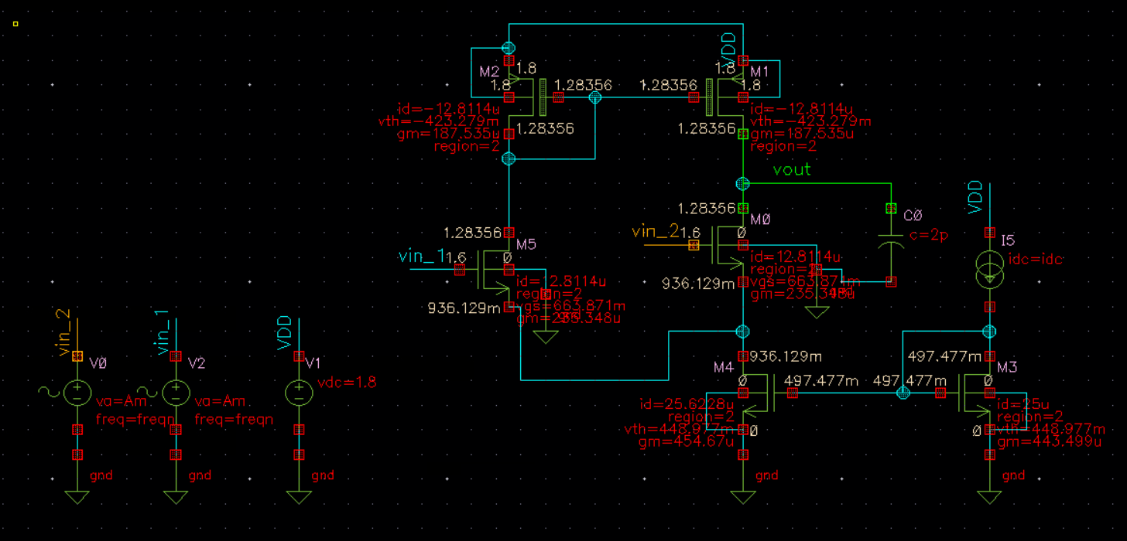
Differential Amplifier :-
DC analysis circuit diagram :-
VCM = 1.6V

Slide 11
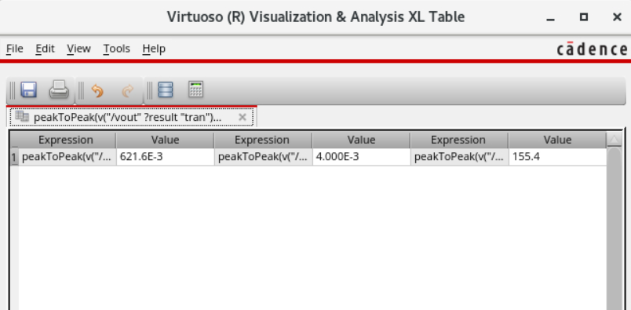
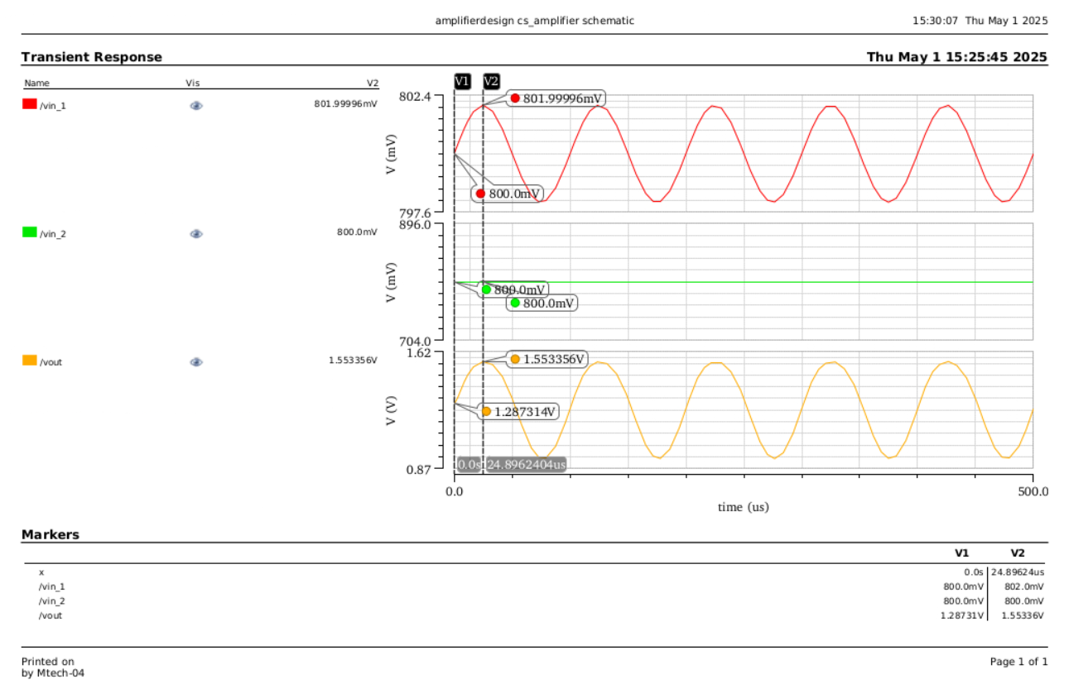
Differential Amplifier :-
Transient analysis :-
VCM = 0.8V

Slide 12
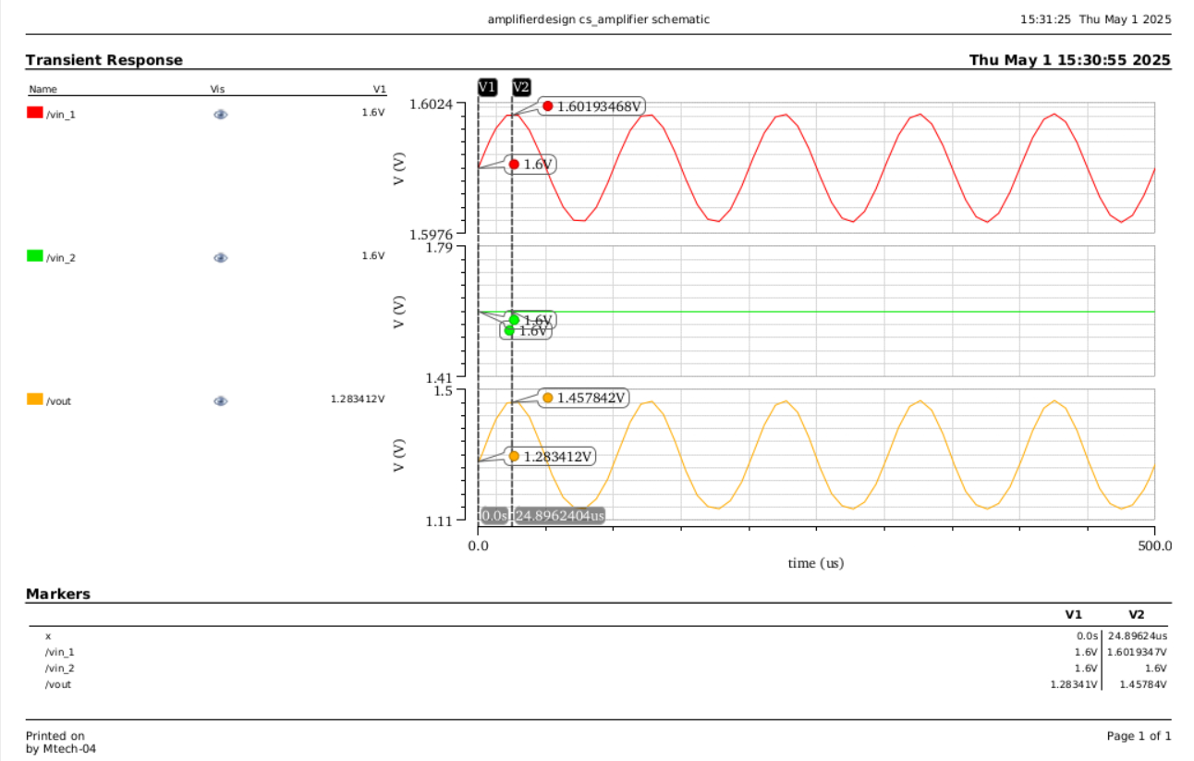
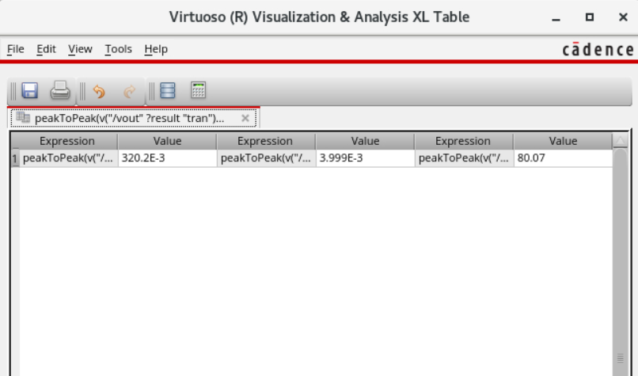
Differential Amplifier :-
Transient analysis :-
VCM = 1.6V

